Slide 1
Online 9.1, 9.2
All-or-Nothing Atomicity
  In database
  In the interrupt interface
  In a layered application
Before-or-After Atomicity
  Coordinating concurrent threads
Achieving all-or-nothing atomicity
  ALL_OR_NOTHING_PUT
Suggested reading
  9.1, 9.2

Slide 2
Atomicity
Perform a sequence of steps so that they appear to be done as a single indivisible step
  e.g. online shopping
All-or-nothing atomicity
  Mask failure
Before-or-after
  Coordinating concurrent activities
Strong form of modularity
  Hide the fact that the atomic action is actually composed of multiple steps
Notes:
Atomic action in os and architecture
Transaction in database

Slide 3
Sweeping Simplification
In the description of the possible states of a system
  A small number of concurrent activities can have a very large number of potential real time sequence
Provides the basis for a methodical approach to
  recovery from failures and
  coordination of concurrent activities
Simplifies
  design
  understanding for later maintainers
  verification of correctness

Slide 4
All-or-Nothing Atomicity in a Database
procedure TRANSFER (db_account, cr_account, 10)
1 GET dbdata
2 dbdata -- 10
3 PUT dbdata
4 GET crdata
5 crdata + 10
6 PUT crdata
What happens if there is a system crash at line 4?
What happens if there is power failure at line 5 or 6?

Slide 5
All-or-Nothing Atomicity in the Interrupt Interface
Exception occurs at the application level
  I/O interrupt handler
    Alerts some other thread
    Returns control to the interrupted thread
    Before-or after atomicity between the handler and the thread
      e.g. ADVANCE should before-or-after call to the thread manager
  Synchronous exception
    Exception handler in the same context
      Examining the state of the action being performed by the thread
        Completed or not

Slide 6
All-or-Nothing Atomicity in the Interrupt Interface
All-or-nothing report of the state is preferred
  Instruction caused the exception
    Either completed
    Or did nothing
    The state is described entirely with values belonging to the layer running the interrupted thread
In-the-middle report
  Increment address mode (r++)
  Page fault
Notes:
R_addr ++
data = *R_addr
R_val += data

Slide 7
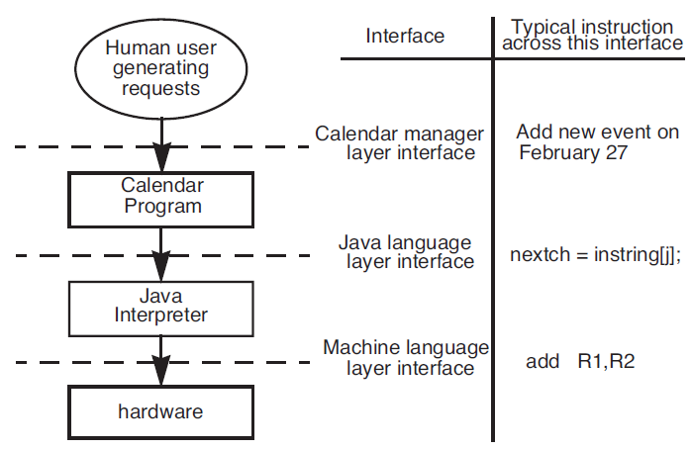
All-or-Nothing Atomicity in a Layered Application

Slide 8
All-or-Nothing Atomicity in a Layered Application
How to handle the register overflow at the lowest level?
  Avoid in-the-middle report
  “Overflow exception caused by the ADD instruction at location 41574”
The failure propagates all the way back to the human user
  “You tried to add an event on a non-existent date”
  Some layer run to completion
    Hardware and the Java interpreter
  Others back out
    The calendar program

Slide 9
All-or-Nothing Atomicity
A sequence of steps is an all-or-nothing action if, from the point of view of its invoker, the sequence always either
  complete,
or
  Abort （ in such a way it appears that the sequence had never been undertaken in the first place. That is, it backs out）

Slide 10
All-or-Nothing Atomicity
Page-fault exception
  The instruction should be all-or-nothing
    It can be re-executed
  Otherwise
    In-the-middle report
Slow system call (READ) being interrupted
  An all-or-nothing design that implements the “nothing” option (blocking read, READ & AWAIT)
  An all-or-nothing design that implements the “all” option (non-blocking read)
  A blocking read design that is neither “all” nor “nothing” and therefore not atomic

Slide 11
Before-or-After Atomicity
Concurrent actions have the before-or-after property
  if their effect from the point of view of their invokers
  is the same as if the actions occurred
    either completely before
    or completely after
  one another
Sequence coordination vs. before-or-after atomicity

Slide 12
Before-or-After Atomicity
procedure TRANSFER (reference debit_account, reference credit_account, amount)
debit_account ← debit_account - amount
credit_account ← credit_account + amount
Two concurrent thread
  TRANSFER (A, B, $10)
  TRANSFER (B, C, $25)
  Account A initially containing $300
  Account B initially containing $100

Slide 13
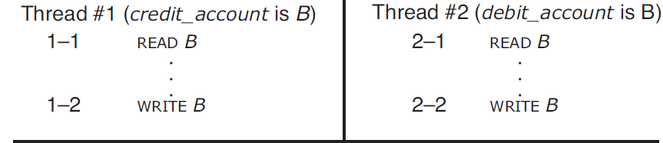
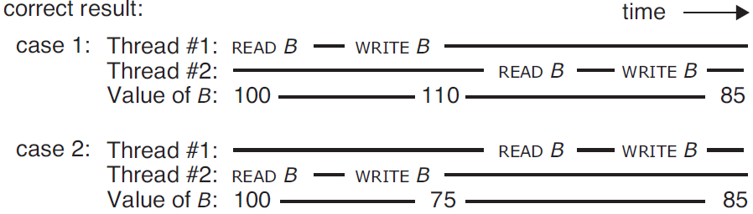
Before-or-After Atomicity

Slide 14
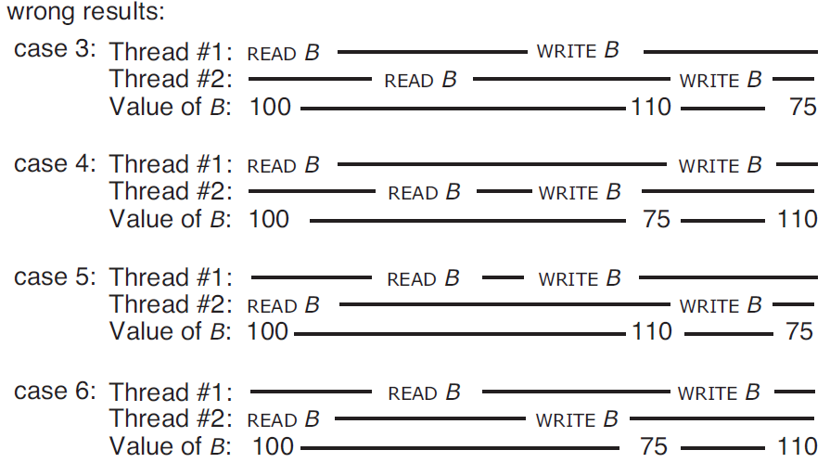
Before-or-After Atomicity

Slide 15
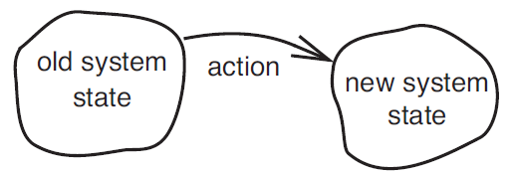
Before-or-After Atomicity
The old state of the system was correct from the point of view of the application
The action, performing all by itself, correctly transforms any correct old state to a correct new state

Slide 16
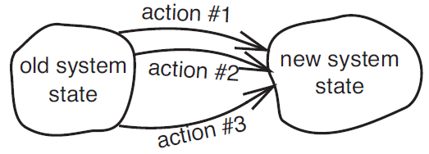
Before-or-After Atomicity
Coordination among concurrent actions can be considered to be correct
  if every result is guaranteed to be one
  that could have been obtained by some purely serial application of those same actions

Slide 17
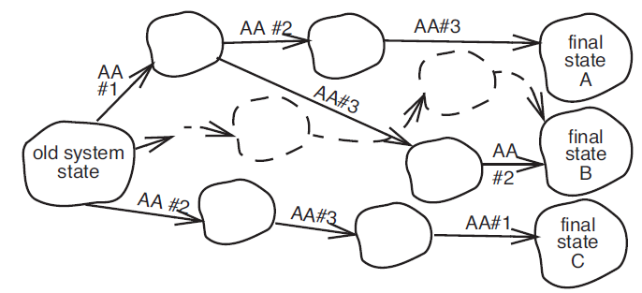
Before-or-After Atomicity
As long as the intermediate states are not visible above the implementing layer, and the system is guaranteed to end up in one of the acceptable final states。 OK

Slide 18
Before-or-After Atomicity
Serializable
  There exists some serial order of those concurrent transactions---→
    that would lead to the same ending state
As the number of concurrent actions and the number of steps in each action grows
  a rapidly growing number of possible orders
  only some will ensure a correct result

Slide 19
Before-or-After Atomicity
The purpose of concurrency is to gain performance
  Like to have a way of choosing from the set of correct orders the one that has the highest performance
  it can in general be quite difficult
Correct requirement is stronger than serializablility in some cases
  External time consistency in banking system
  Sequential consistency in processor

